Slide 1


TRiCAM QRI Project Presentation
MICHELLE YANG, AKASH LEVY, ALBERT TUNG, JANETTE GARCIA

Slide 2
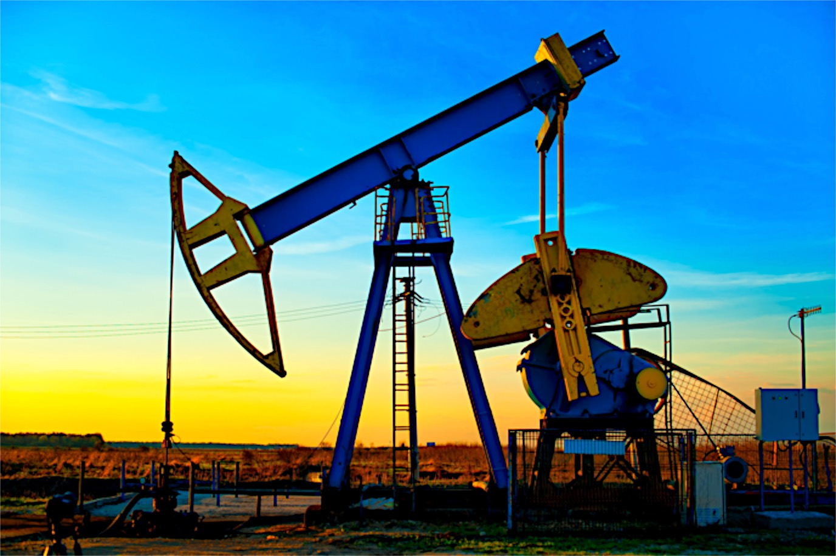
QRI Problem Summary
Goal: predict oil production rate in petroleum wells
Strategy: deep learning
Models:
Convolutional Neural Network (CNN)
Multilayer Perceptron (MLP)
Recurrent Neural Network (RNN)
Restricted Boltzmann Machine (RBM)

Slide 3
QRI Data – Current Preprocessing
Split data into chunks of 36 months
Step size of 1 month
Assign data to training, validation, and test sets
Based on different wells
Remove zeros
Normalize data within each chunk

Slide 4
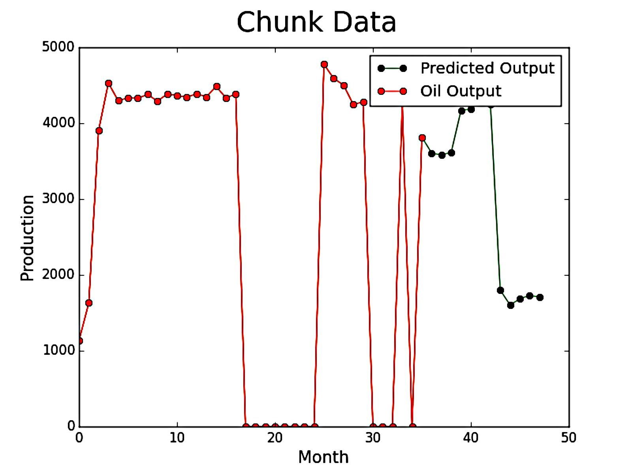
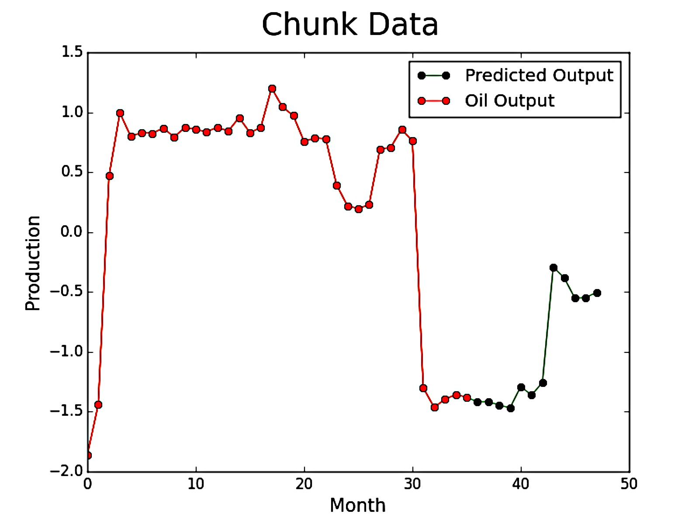
Sample Preprocessed Data
Original
Current Preprocessing

Slide 5
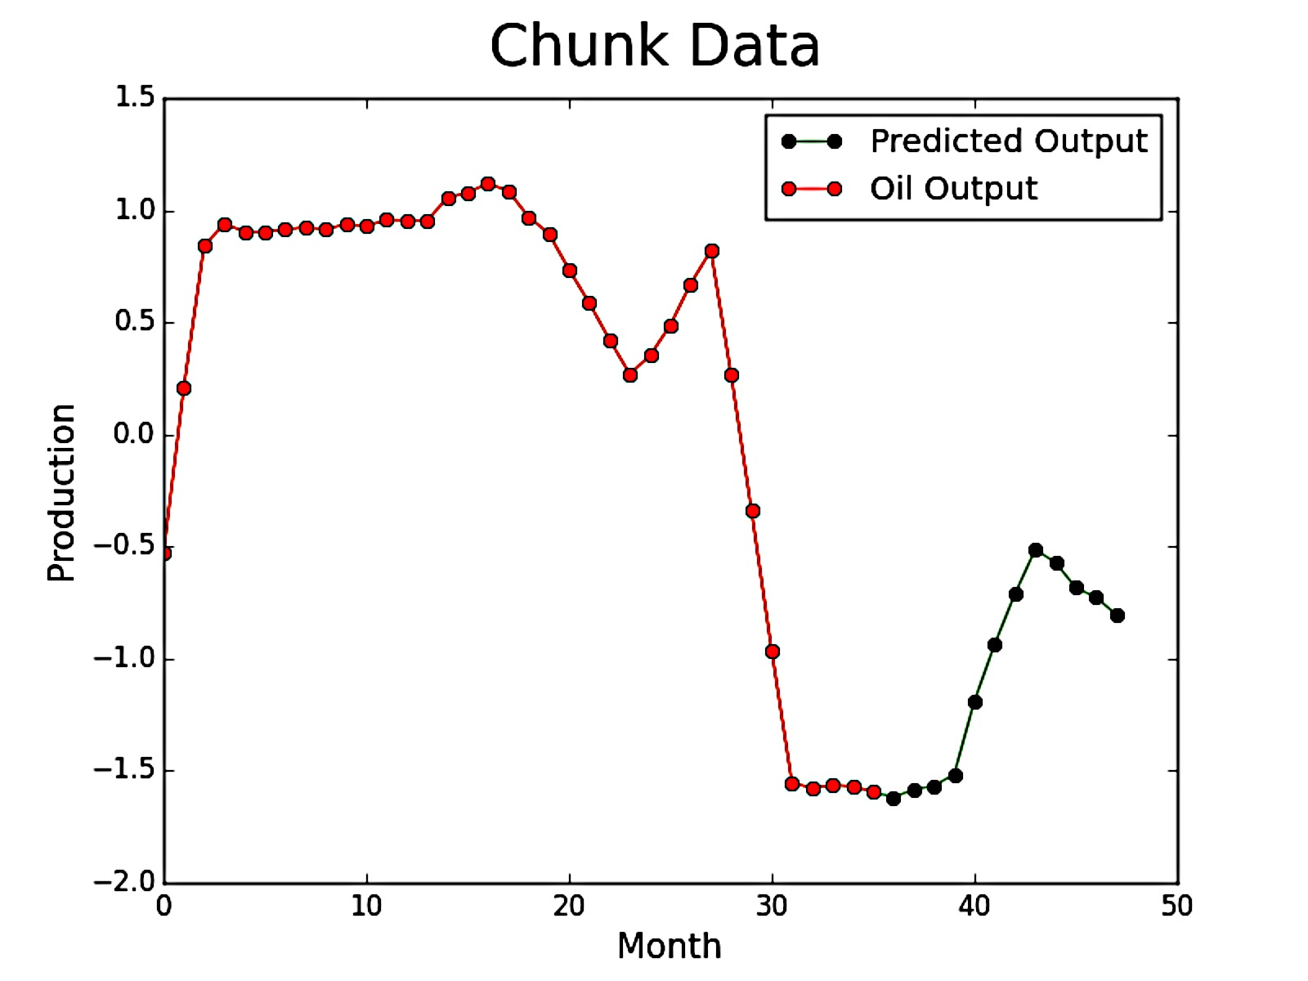
Additional Preprocessing Options
Smoothing data
Assign data to different sets based on site name

Slide 6
Odyssey Clusters
Successfully set up
Ran on CPU
Next Step: running on GPU

Slide 7
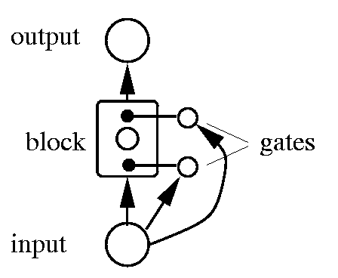
Recurrent Neural Networks (RNN)
Character-level language modeling:
Predicted lowest-level term
Developing Long Short Term Memory Model (LSTM)

Slide 8
Restricted Boltzmann Machines (RBM)
Ran MNIST data
Editing shape of input data

Slide 9
Convolutional Neural Network (CNN)
Working model on QRI data
Hidden layers: 2
Fully-connected layer: 1
Filter per layer: 12
Activation Function: tanh
Batch size: 200
Learning rate: 0.01
Momentum: 0

Slide 10
CNN on QRI Data
Animated prediction

Slide 11
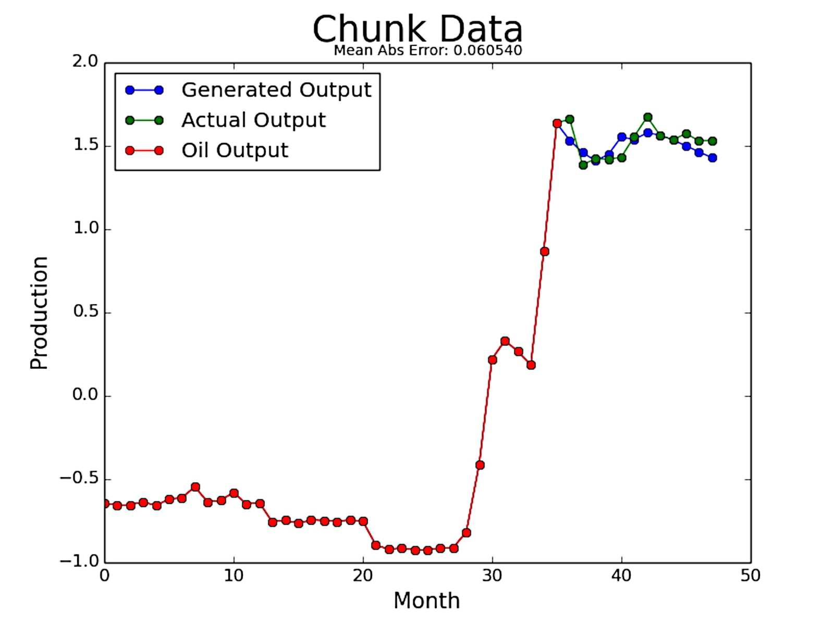
Multilayer Perceptron (MLP)
Changed from autoencoders
Currently produces best results on QRI data
Hidden layers: 4
Neurons: 300
Activation Function: tanh
Batch size: 273
Learning rate: 0.01
Momentum 0.5

Slide 12
MLP on QRI Data
Animated prediction

Slide 13
Training on QRI Data
Convolutional Neural Network (CNN)
Multilayer Perceptron (MLP)

Slide 14
Training on QRI Data
Convolutional Neural Network (CNN)
Multilayer Perceptron (MLP)

Slide 15
Training on QRI Data
Convolutional Neural Network (CNN)
Multilayer Perceptron (MLP)

Slide 16
Training on QRI Data
Convolutional Neural Network (CNN)
Multilayer Perceptron (MLP)

Slide 17
Training on QRI Data
Convolutional Neural Network (CNN)
Multilayer Perceptron (MLP)

Slide 18

Thank you!
Questions?

Slide 19
Works Cited
Picture slide 2: http://www.sfltimes.com/wp-content/uploads/2015/06/oil-drilling-at-sunset.jpg
RNN LSTM picture: http://www.willamette.edu/~gorr/classes/cs449/figs/lstm.gif
Smiling corgi: http://dailynewsdig.com/wp-content/uploads/2013/11/15.-Smiling-Corgi-Pup.jpg

